Slide 1
Nassau County Museum of Art
blue.
Instead of visiting the Nassau County Museum with your class, we are bringing the Museum to you!
We have put together a series of art explorations using works from our current exhibition, which is all about the color blue. This one is about shapes! We hope you enjoy it and can’t wait to see you in our galleries soon.
P.S. What’s YOUR favorite color?

Slide 2
blue.
Shapes
In this unit we will look at how artists explore the basic art element of shape in different ways. First, you will be able to look at an image with nothing to distract you. Then you will see a few questions to help you deepen your looking.
Remember, there are only right answers!

Slide 3
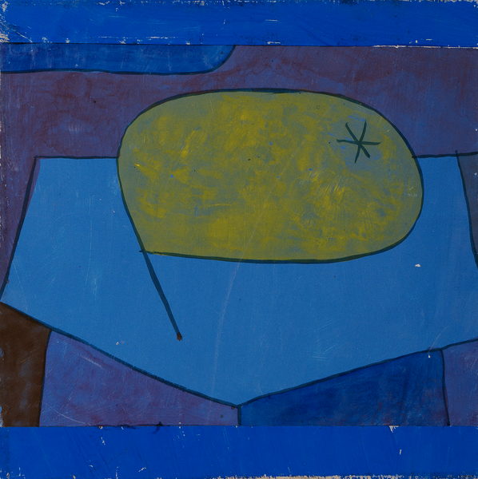

Slide 4
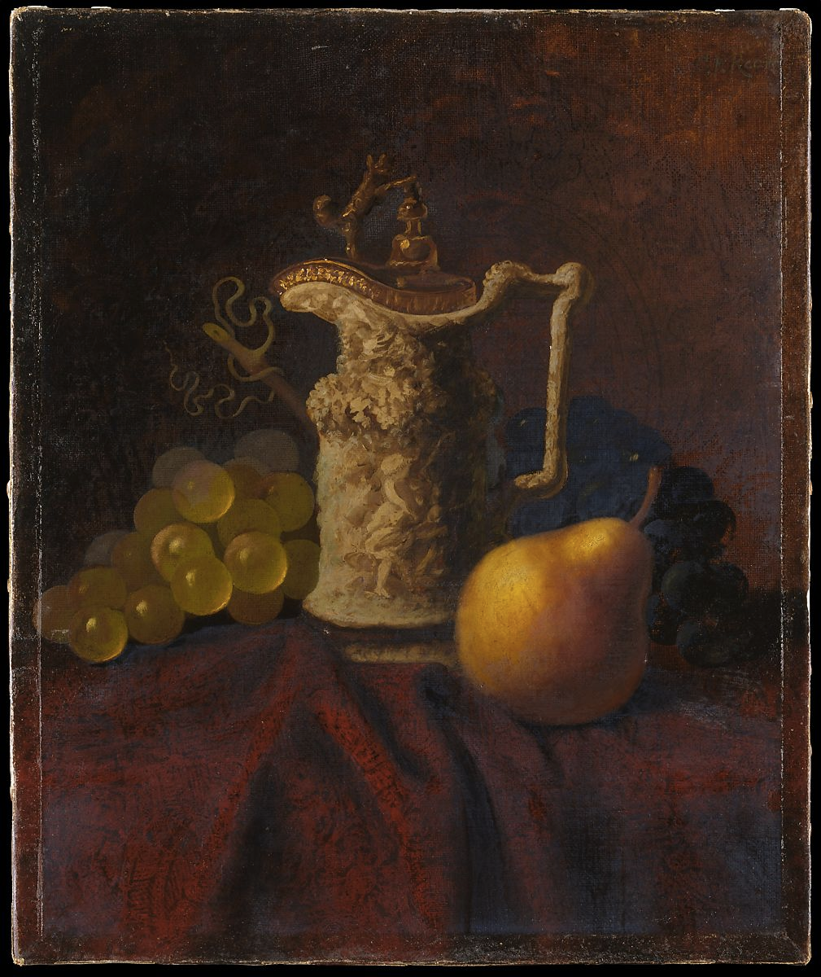
What looks real and unreal about Paul Klee’s pear?
Compare these two still lifes. How does each artist think about texture, color, perspective and scale?
What would you say was most important to each artist?
Paul Klee. Beulen Birne (Bulgy Pear). 1934
Carducius Plantagenet Ream, Still Life wife with Ewer and Fruit. Late 19th/early 20th century

Slide 5
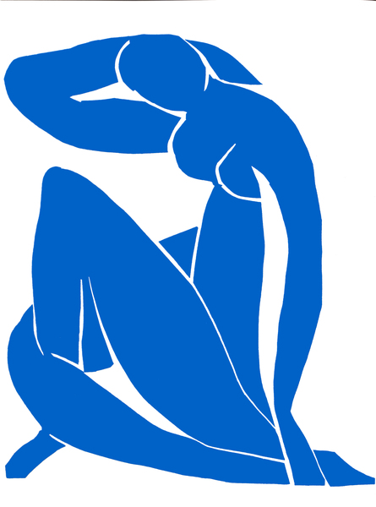

Slide 6
Matisse tried to reduce the human figure into its’ most essential shapes.
He cut these shapes out of paper and then applied them to his canvas.
Try to distinguish each separate cutout. How many shapes did he use?
Observe a person or object in your home and try to draw them/it in only a few simple shapes.
Henri Matisse. Nu Blue II

Slide 7
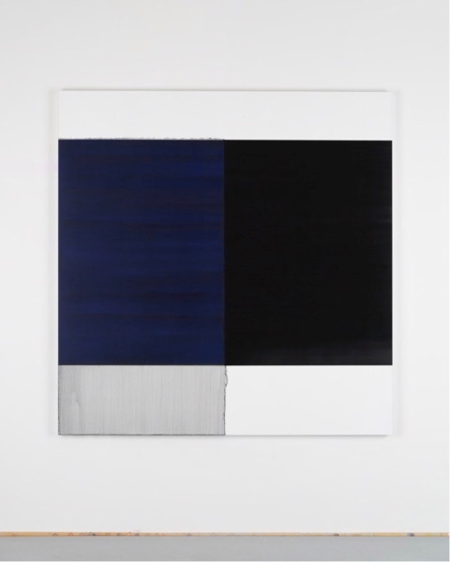

Slide 8
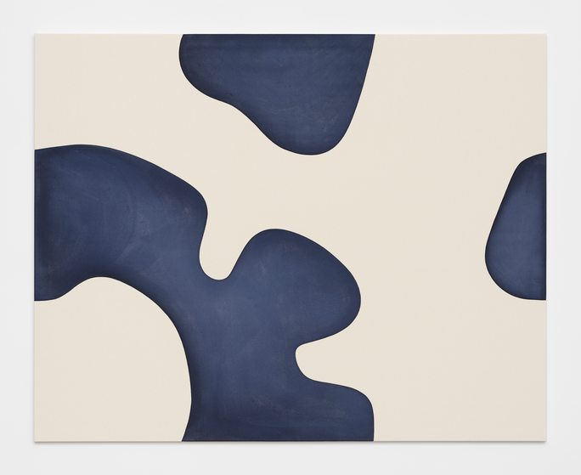

Slide 9
These artists are abstract expressionist painters. They are using line, shape and color to express themselves, rather than painting something that looks “real.”
What is the same about these two works? Different?
Which work seems more active? Which one seems calm?
Are you reminded of anything by these works?
Which one would you rather have in your bedroom? Why?
Callum Innes
Landon Metz. Untitled. 2018

